Slide 1
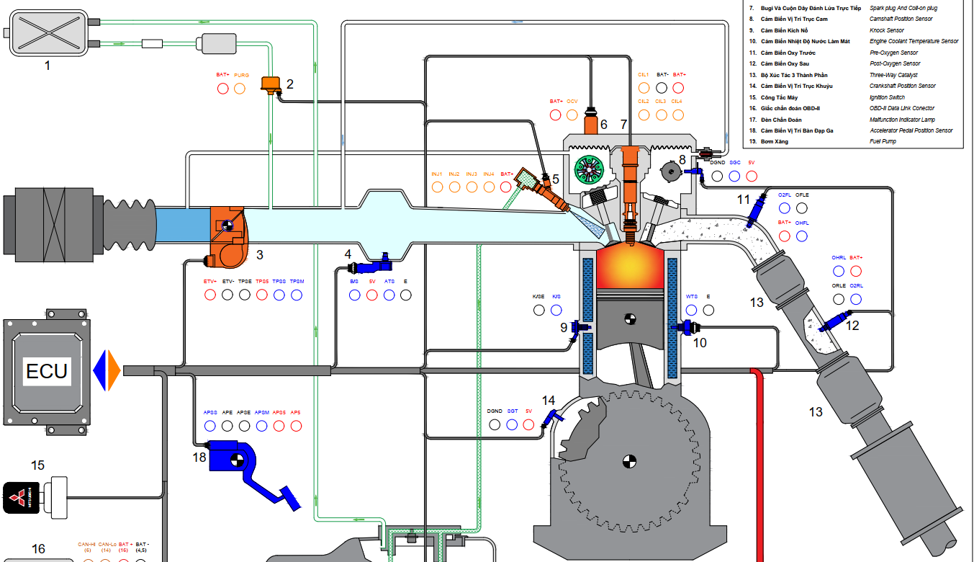

1. Summarize the sources of harmful emissions from ICE-powered vehicles, especially gasoline fueled ICEs, and common solutions to reduce these harmful emissions.

Slide 2
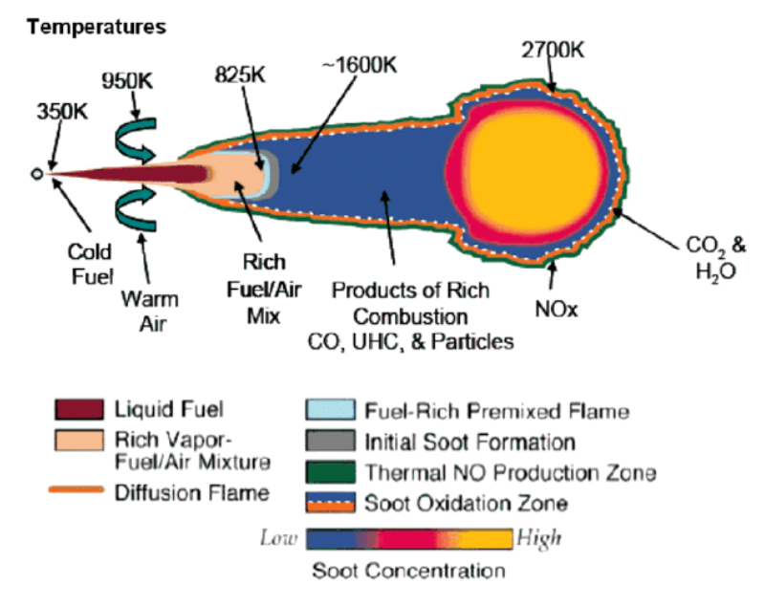

Slide 3
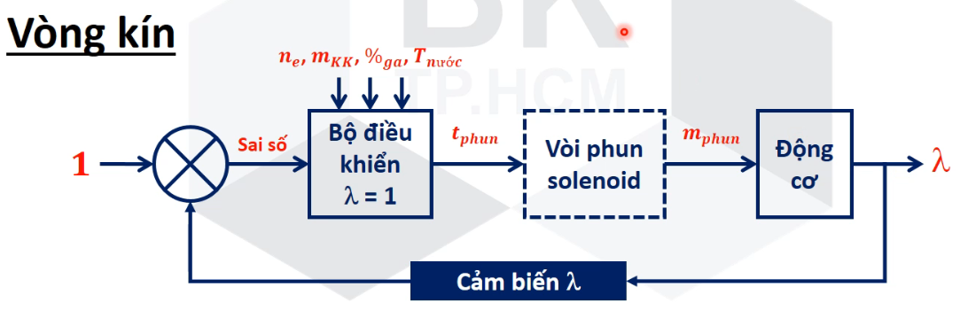
2. Explain the operating principle of lambda = 1 closed-loop control in gasoline engines.
Overall diagram of lambda = 1 closed-loop control?

Slide 4
2. Explain the operating principle of lambda = 1 closed-loop control in gasoline engines.
The roles of three-way catalyst (TWC), lambda sensor and electronic fuel injection system?
ECU
Electric fuel injection system
Lambda sensor
TWC

Slide 5
2. Explain the operating principle of lambda = 1 closed-loop control in gasoline engines.
Oxidation and reduction reactions occuring in TWC?
ECU
Electric fuel injection system
Lambda sensor
TWC

Slide 6
2. Explain the operating principle of lambda = 1 closed-loop control in gasoline engines.
Requirements of exhaust gas compositions, and so air-fuel mixture, to promote these reactions?
lambda
lambda > 1
lambda > 1
lambda < 1
t

Slide 7
2. Explain the operating principle of lambda = 1 closed-loop control in gasoline engines.
Why should lambda value be adjusted to oscillate around 1 instead of being exactly equal to 1?
lambda
lambda > 1
lambda > 1
lambda < 1
t

Slide 8
2. Explain the operating principle of lambda = 1 closed-loop control in gasoline engines.
How does the loop control work?

Slide 9
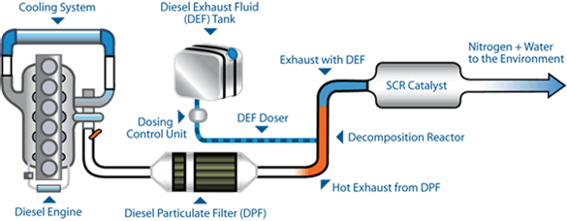
3. Explain exhaust gas aftertreatment solutions in modern diesel engines. Layout of exhaust system in modern diesel engine?
The role of each component in the exhaust gas aftertreatment?

Slide 10
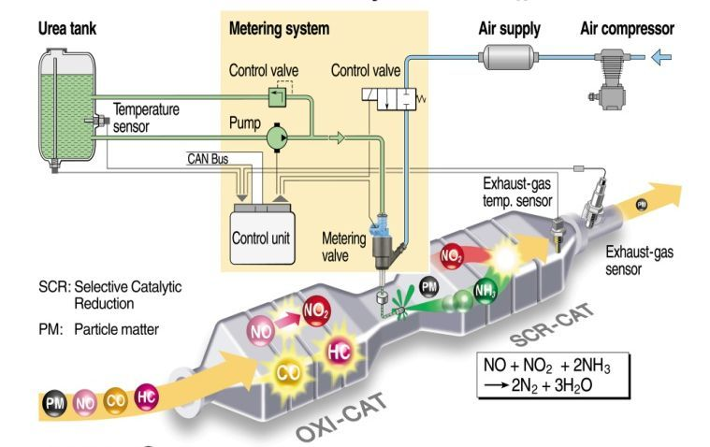
3. Explain exhaust gas aftertreatment solutions in modern diesel engines. Layout of exhaust system in modern diesel engine?
The role of each component in the exhaust gas aftertreatment?

